Slide 1

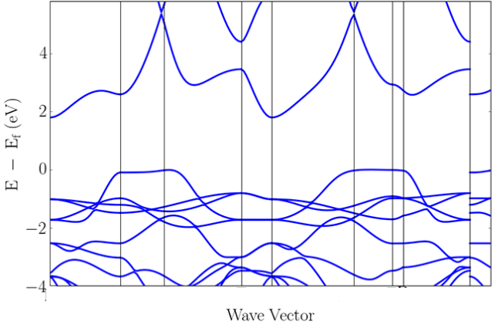
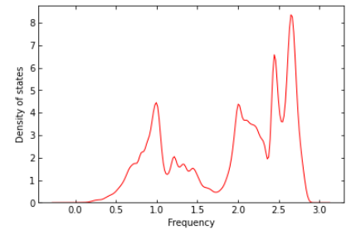
Computational Physics Workshop
Tanya C., Prakriti S., Carlos M.
Electronic Bands
Density of States (Phonons)

Slide 2
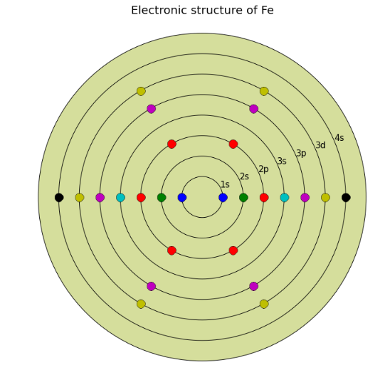
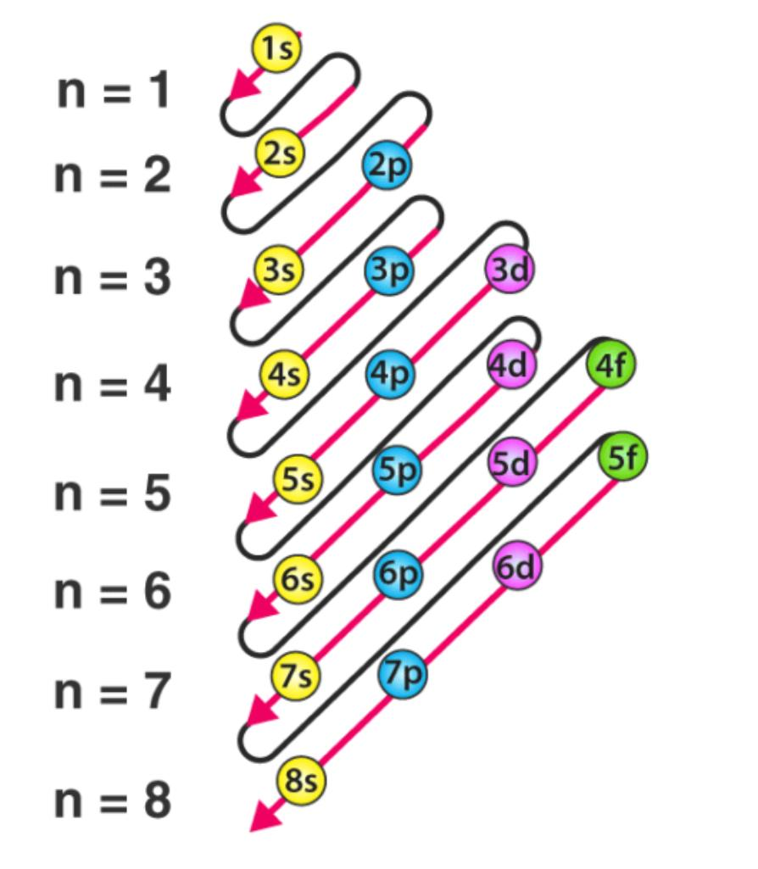

Pymatgen can plot the electronic structure of an element

Slide 3
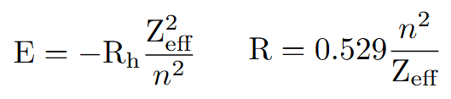
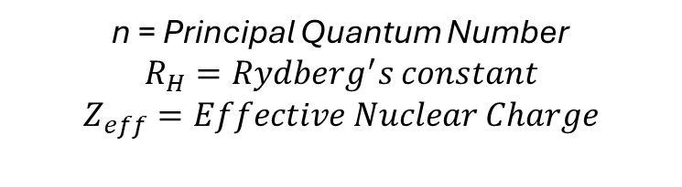
Pymatgen can plot the electronic structure of an element
From the picture, we want to compute:
the energy of the element
The atomic radius
n = Principal Quantum Number
$$R_{H}=Rydberg^{′}s constant$$
$$Z_{eff}=Effective Nuclear Charge$$

Slide 4
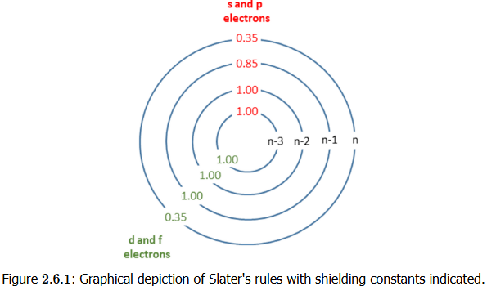
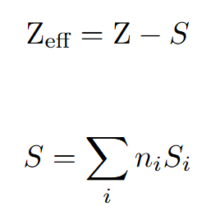
Slater’s rules give an approximation of the effective nuclear charge

Slide 5
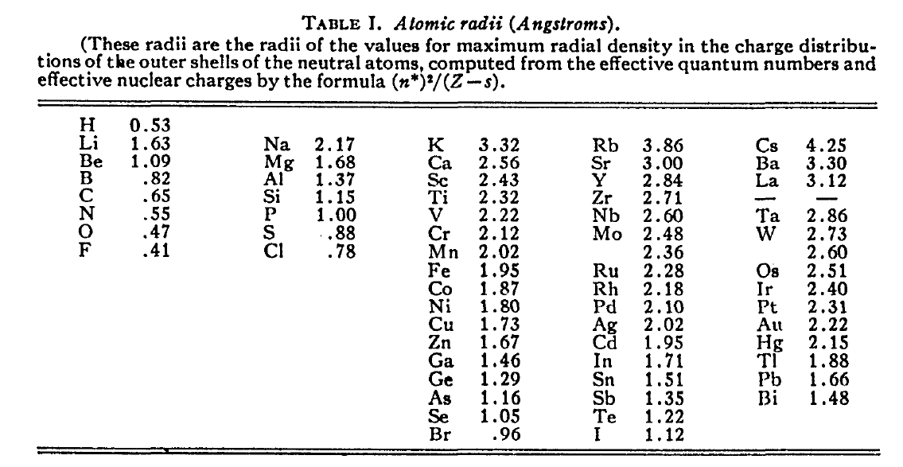

Slide 6
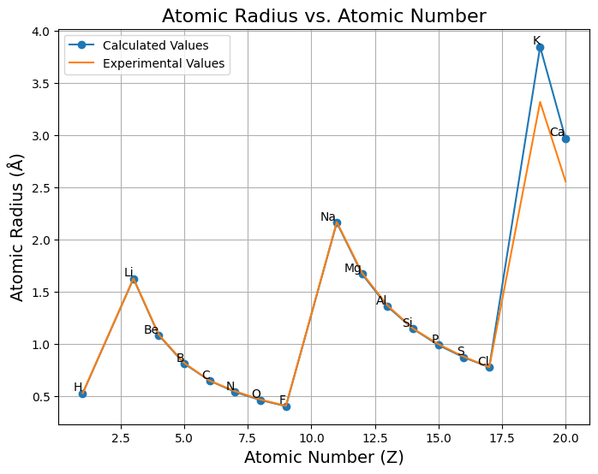
Exercise Validation

